Slide 1
SHOP
Online Store using E-commerce and Database Design and Implementation
Authors-
Md. Tariqul Islam
Md. Shohel Mojumder
Name-Parth Pawar
Roll no.-1911103

Slide 2
What is E-commerce?

Slide 3
Merits of E-Commerce
PAY
Faster Buying Process
1
Prevents wastage of time
Store and product Listing Creation
2
Makes it easier for seller to market their products
Cost Reduction
3
Seller’s expenses decreases
Flexibility of customers
4
Service available 24/7
5
Affordable advertising and marketing
Many features are available related to marketing

Slide 4
Merits of E-Commerce
PAY
Product and Price Comparison
6
Gives fair idea of the actual cost of a product
No Reach Limitations
7
Diminishes physical barriers
Faster response to buyer/market demands
8
Less delay between placement of order and delivery
Several Payment Methods
9
Wide variety of options available for payment

Slide 5
Proposed System
02
03
01
04
Low Cost
Basic Computer Knowledge Required
Providing Security
SHOP
Configurable and Extensible application UI design

Slide 6
Proposed System Analysis
This system is all about the converting the shopping system from manual to online.
Customer can buy products online after logging in to the site.
Administrator can add products to database.
Administrator can edit or delete the products from the database.

Slide 7
After buying and making payment, the products are send to customers’ address that has been given.
Customer can see the price list of the products.
Admin can change password and add new admin.
Admin can see daily and previous order lists.
Admin can delete daily and previous order lists.

Slide 8
Implementation Details
Category Details
Input: The category table stores the input category name and it should be unique so that the category name is not repeated.
Output: All the pages of the website display entire category name.
Sub-Category Details
Input: The subcategory table store the input subcategory name and the subcategory name are included under the category name.
Output: Subcategory name should be displayed when user clicks on the category name in the dropdown menu.

Slide 9
Implementation Details
Product Details
Input: Input the details of the product that is product name, price, discount, description of the Product, Upload Photo, and quantity.
Output: The details of the product are displayed on the website.
Input: Input whether the product is featured or not.
Output: If featured, the product will be displayed on the front page of the website.

Slide 10
Implementation Details
Customer Details
Input: Input Username, Password, email of the user.
Output: User will login using this username and password.
Input: Input first name, last name, address, city, zip code, Phone number, email of the customer for the checkout.
Output: Administrator will see the details of the customer in the order list page.

Slide 11
Implementation Details
Administrator Details
Input: Input Username, password & confirm password to create new administrators.
Output: Using the created username and password administrator will access the admin section.
Role of Administrator
Keep details regarding new user registrations
Keep track of orders of users

Slide 12
Functional Requirements
Keeping records of customers.
Keeping records of the category, subcategory and their products.
Keeping the daily and previous orders list.
Storing the items selected by the customer in the temporary storage.

Slide 13
Functional Requirements
Provide the checkout functionalities to the customer to buy the products.
Keeping the company’s shipping and delivery information.
Provide searching facilities to search for various products.

Slide 14
Non-functional Requirements
Secure access of confidential data like customer’s details.
24 X 7 availability of services.
Better component design to get better performance at peak time.
Flexible service based architecture which will be highly desirable for future extension.

Slide 15
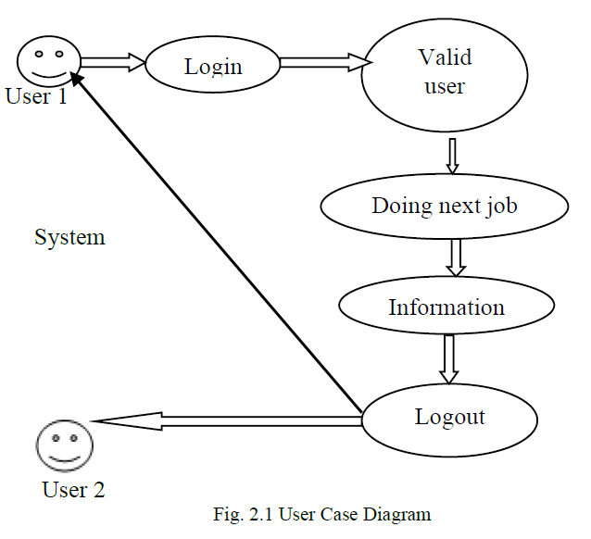
User Case Diagram
User enters his credentials
User is authenticated
User performs his tasks
Transfer of information occurs
User logs off the system

Slide 16
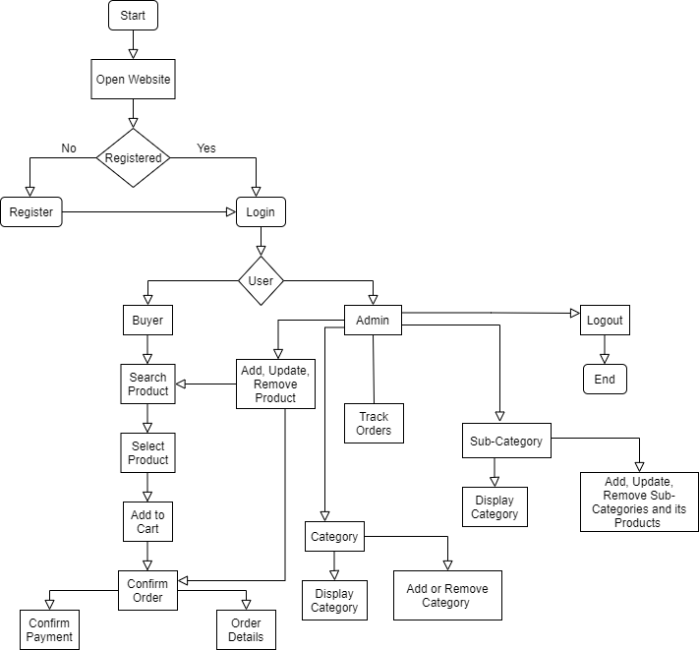
System
Flowchart

Slide 17
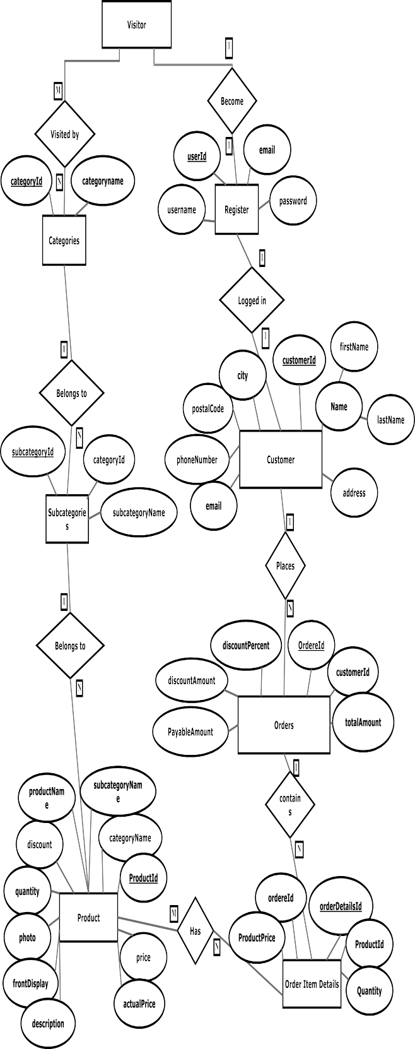
E-R Diagram

Slide 18
Conclusion
The main goal was to design and implement an effective online shopping system.
E-commerce is a booming industry because of the flexibility it provides.
All the requirements and implementation details have been clearly stated.

Slide 19
Strategy for Implementation
Create a functional E-commerce Website
Mysql for creating database
Html and Php for developing the website
Bootstrap for styling

Slide 20
References
Md. Tariqul Islam , Md. Shohel Mojumder, 2020, Online Store using E-Commerce and Database Design and Implementation, INTERNATIONAL JOURNAL OF ENGINEERING RESEARCH & TECHNOLOGY (IJERT) online-store-using-e-commerce-and-database-design-and-implementation-IJERTV9IS100168
https://services.amazon.in/seller-blog/advantages-of-ecommerce.html
https://slidesgo.com/
https://www.freepik.com/

Slide 21
Thank You!

